Slide 1
Bhashathon
ASR Output Correction

Slide 2
Table of contents
Team Details and Problem Statement
Dataset Preparation
Pre-processing
Experiments
Architecture
Training Approach
Performance
Limitations
Notebooks
References

Slide 3
Team Details & Problem Statement
Team name: Global Optima
Team Members:
Disha Timbadiya
Vrund Dobariya
Om Soni
Problem Statement: ASR Output Correction
Language: English, Hindi, Malayalam.

Slide 4
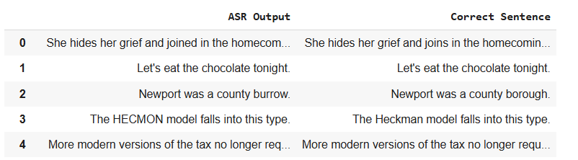
Dataset Preparation
Dataset used for training: Common Voice Dataset (Delta 20,19,18, and 17 releases) from Mozilla
License: CC BY 4.0 (Creative Commons Attribution 4.0)
We used whisper-tiny and s2t small models for generating transcriptions for audio files.
Dataset format:
Dataset links:
Generated with S2T-small [1935 samples]
Generated with whisper-tiny [1446 samples]

Slide 5
Preprocessing
Text Preprocessing:
Sentences are converted to lowercase(For English) to ensure uniformity.
Leading and trailing spaces are removed to clean the input data.
Data Filtering:
Sentences with more than 2 unmatched words between the reference and the generated transcript are excluded to maintain data quality.
Transcripts generated in languages other than the target language were removed to ensure consistency.

Slide 6
Experiments
Base Models Experimented:
Using T5-small & Flan-T5-base Transformer
t5-small
flan-t5-base
Fine Tuning Small Language Models for ASR Correction
SmolLM2-360M
Fine Tuning facebook/mbart-large-50 Model
Approach:
Taken pretrained checkpoints of above models
Retrained models for 3 to 4 epochs on a custom ASR correction dataset

Slide 7
Architecture
Decode tokens
Input Sentence
tokenizer
Corrected Sentence
Encoded tokens
Embedding
Fine Tuned transformer
( T5 / Small LLM / mBART-large-50 )
Self Attention
Multilayer Perceptrons
Output

Slide 8
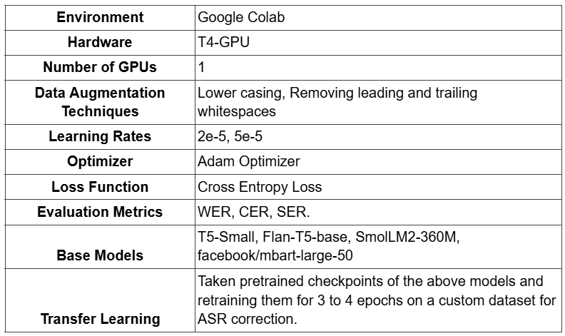
Training Approach

Slide 9
Performance
For English Language:
Metrics | Fine Tuned LLM Smollm-v2 | Fine Tuned Transformer t5-small | Fine Tuned Transformer google/flan-t5-base | Fine Tuned facebook/mbart-large-50
WER | 21% | 14.94% | 11.21% | 5.80%
CER | 15% | 64.7% | 55.7% | 3.21%
SER | 90% | 70.84% | 58.26% | 36.02%
Based on the evaluation metrics, the Fine-Tuned facebook/mbart-large-50 model is finalized as it achieves the lowest WER (5.80%), CER (3.21%), and SER (36.02%) for English, making it the best for ASR error correction.

Slide 10
Performance
For Hindi Language:
For Malayalam Language:
Metrics | Fine Tuned facebook/mbart-large-50
WER | 13.11%
CER | 9.81%
SER | 40.44%
Metrics | Fine Tuned facebook/mbart-large-50
WER | 5.85%
CER | 1.27%
SER | 25.31%

Slide 11
Limitations
Challenges Encountered:
Domain-Specific Contexts: Struggles with specialized fields (e.g., medical, technical).
Ambiguity in Transcription: Difficulties when there's a significant mismatch between transcribed and actual words.
Model Performance:
Larger Models: Models with higher parameters (1b, 1.5b, 3b) tend to perform better on challenging tasks.
Development Trade-offs:
Computational Cost: Fine-tuning large language models requires significant computational resources.

Slide 12
Notebooks
Colab Notebooks:
mBART fine-tuning for English
mBART_fine-tuning_for_hindi
mBART_fine-tuning_for_Malayalam
T5-Small fine-tuning For English - Experiment
FlanT5- base fine tuning for English - Experiment
Using LLM for English - Experiment

Slide 13
References
https://huggingface.co/HuggingFaceTB/SmolLM2-360M
https://huggingface.co/blog/smollm
https://www.isca-archive.org/interspeech_2024/li24h_interspeech.pdf
https://ieeexplore.ieee.org/document/10094690
https://ojs.aaai.org/index.php/AAAI/article/view/26531/26303
https://research.google/pubs/red-ace-robust-error-detection-for-asr-using-confidence-embeddings/
https://arxiv.org/abs/2409.09554

